Slide 1

Basic Details of the Team and Problem Statement
Ministry/Organization Name/Student Innovation:
AICTE, MIC-Student Innovation
PS Code: SIH1493
Problem Statement Title: Student Innovation
Team Name: Komet
Team Leader Name: Abhijit Patil
Institute Code (AISHE): U-0760
Institute Name: Indian Institute of Information Technology, Sri City, Chittoor
Theme Name: Heritage & Culture

Slide 2
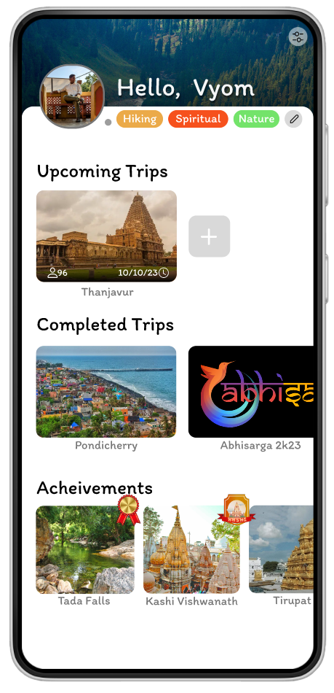

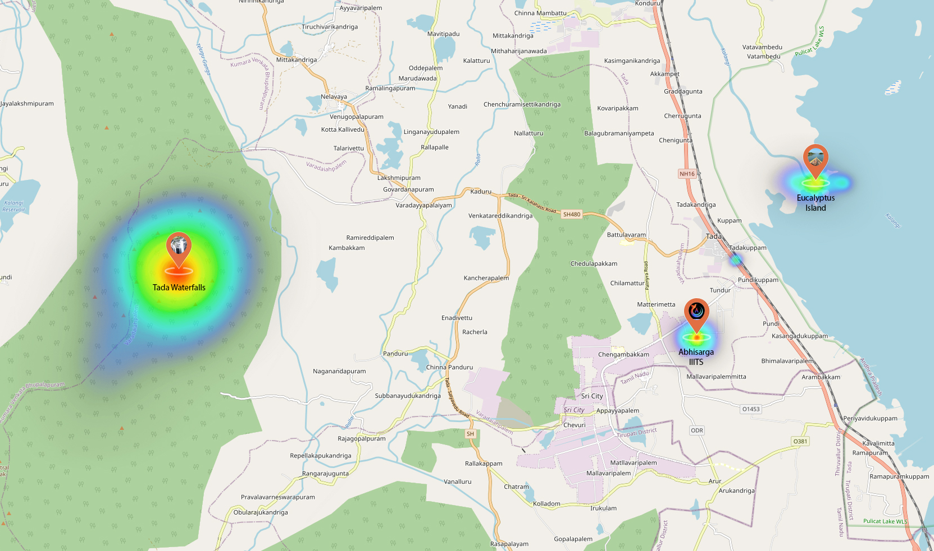
















Idea/Approach Details
India is a very diverse country with rich heritage and a culture that dates back to the genesis of humanity itself. In fact Indian civilization is one of the oldest civilization to exist.
But now-a-days due to globalization and foreign influence many Indians have forgotten their roots
The key objective of this project is to put this incredible diversity and heritage to good use and help other fellow Indians benefit from it.
A times of India study published in march 2019 says that almost 80% of all small scale gathering/trips in India are organised in malls or restaurant and we want to change that .
But to change this first we will need to find out the reason behind why do people prefer mall and restaurants over treks to waterfalls or forts.
These are some of the problems that one might face while planning such a trek: 1) Safety issues : some treks are difficult and physically challenging and may need an organized group to complete it
2) Weather : some trips cannot be held in some specific weather conditions
3) Limited transportation: there might not be readily available transportation to some of the remote locations.
4) Limited awareness about such places
Our idea is to make an app that can solve all of these problems and make such a trip planning seamless and hassle free.
Describe your Technology stack here:

Slide 3
Idea/Approach Details
Our AI model considers the above mentioned factors like: weather, season, transportation availability, ideal timeframe, user experience level, user location, popular places, minimal carbon footprint, etc. and plans a perfect trip for the user seamlessly.
The AI plans everything including transportation , meeting point (for the group), lunch breaks and where to eat........... and many more things automatically for the user.
The app also shows public events and trips happening near you which you can join. This will promote socialization and you can find friends which share the same interests as you.
The app features some collectable NFTs that can be collected by completing some specific trips .This will encourage the user to go on more trips to collect as many collectable as possible
The app promotes local/traditional Indian restaurants for mid trip lunches and dinners as an initiative toward vocal for local.
This App will help in contributing to the country's GDP and enhancing the livelihood of less-visited and under-rated locations beyond popular tourist spots.
You can also follow your friends to get notified when they are planning a trip that you can join.
The app also contains the heat map of the current most visited places near you so that you can see what places are trending and plan so accordingly.
The app also contains a feature to calculate the carbon footprint of the whole trip so that the trip can remain eco-friendly
The profile page displays your collected NFTs and previous trip .This helps other ppl who are considering to include you in their trip
Dependencies
Tensorflow
Pandas
Numpy
Open Street Maps
UNESCO Heritage Site Database
Ministry of Tourism Statistics
User Data
Weather Sources ( Open Source )
Android SDK & API
Supabase

Slide 4
Team Member Details
Team Leader Name: Abhijit Patil
Branch : Btech Stream : ECE Year : I
Team Member 1 Name: Gaurav Gautam
Branch : Btech Stream: CSE Year : I
Team Member 2 Name: Vyom Nikhra
Branch : Btech Stream: AI&DS Year : I
Team Member 3 Name: Vedant Kesarwani
Branch : Btech Stream :CSE Year: I
Team Member 4 Name: Abhiraj Singh Chauhan
Branch : Btech Stream : CSE Year : I
Team Member 5 Name: Mallepaga Sarayu
Branch : Btech Stream : CSE Year : I
Team Mentor 1 Name: Type Your Name Here
Category (Academic/Industry): Expertise (AI/ML/Blockchain etc): Domain Experience (in years):
Team Mentor 2 Name: Type Your Name Here
Category (Academic/Industry): Expertise (AI/ML/Blockchain etc): Domain Experience (in years):

